Slide 1


—
Administrative Law 2025
Week 5 Introduction to Jurisdictional Review
Dr Richard Taylor
Lecturer, School of Law

Slide 2
Week 5 Overview
Judicial Review Overview
Judicial Review vs Merits Review
Types of Judicial Review
In this week’s lecture, we will work through the concepts concerning judicial review
Common Law
Constitutional
Statutory
Concept of Justiciability
Jurisdictional Error
Summary

Slide 3
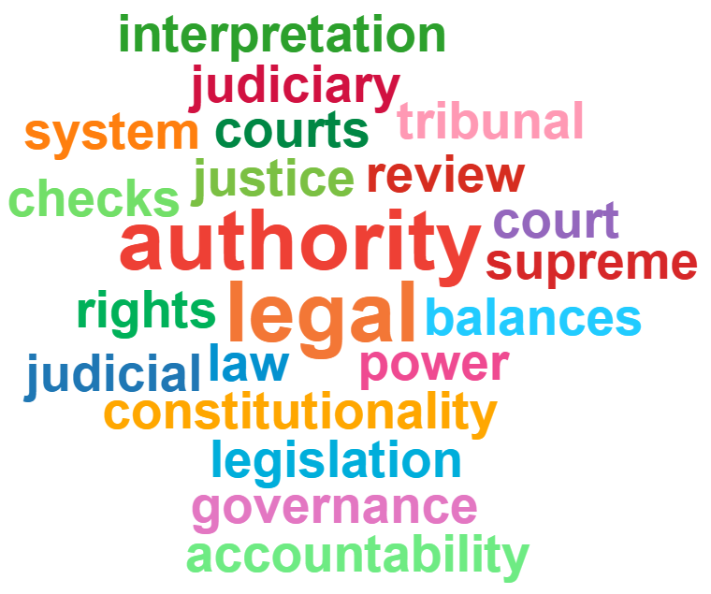
Types of Judicial Review
Judicial control over administrative action is about the supervisory role of courts over government and who has the final say when there are disputes over interpretation/application of the law.
There are 3 types of judicial review
1. Common law;
2. Constitutional; and
3. Statutory – i.e. Administrative Decisions (Judicial Review) Act 1977 ( Cth) – aka ADJR Act
Administrative Law –LAW1023

Slide 4
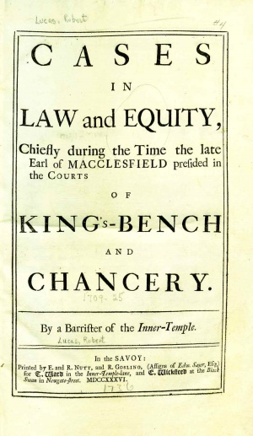
Judicial Review What is It?
Historically courts took a limited approach
Certain prerogative writs available at common law and constitutionally
  Certiorari – quashing a decision
  Mandamus – mandate the making of a decision
  Prohibition – prevent the making of a wrongful decision
Also equitable remedies derived from private law
  Injunctions
  Declaration
Image of writ
Administrative Law –LAW1023

Slide 5
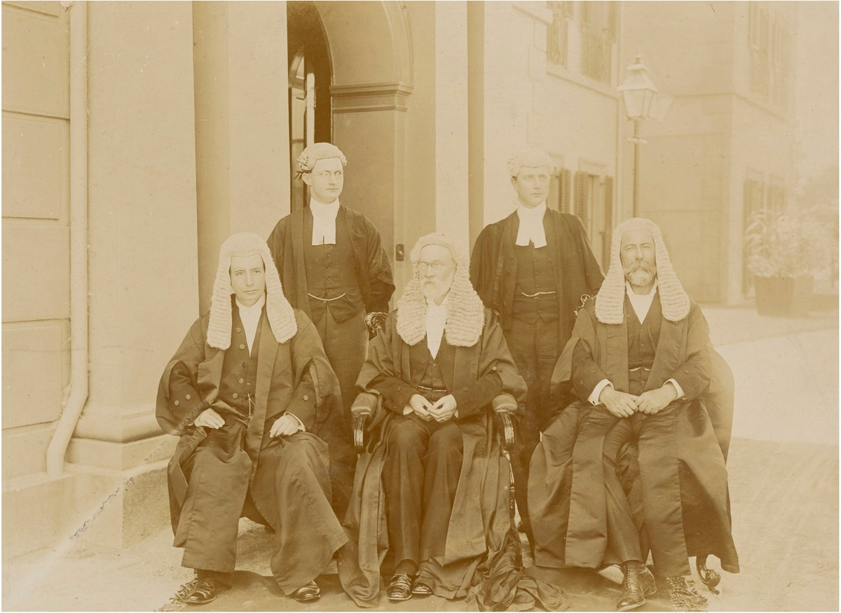
Judicial Review – Grounds of Review
Ultra vires
Improper purpose
Unreasonableness
Uncertainty
Unlawful delegation
Failure to consider a relevant consideration
Denial of natural justice/procedural fairness
Hearing
Bias
Jurisdictional error
Error of law on the face of the record
Case image?
First High Court of Australia: Source: National Portrait Gallery
Administrative Law –LAW1023

Slide 6
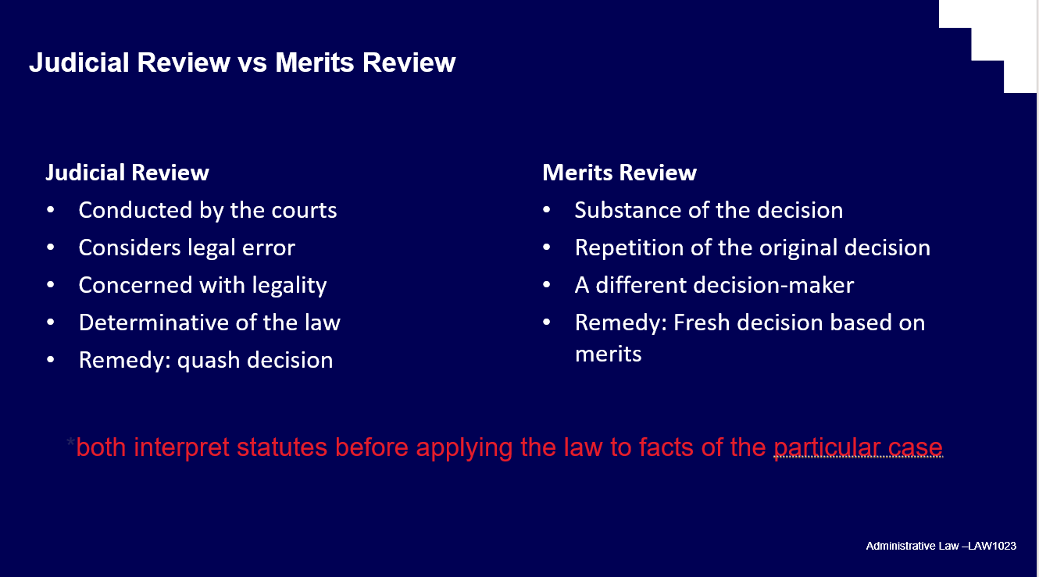
Judicial Review vs Merits Review
This is not merits review – i.e. putting court or tribunal in shoes of the decision maker.
Judicial review makes sure the decision is not ‘tainted’ in some way
  Was this decision within the Minister’s power?
  Was it invalid due to an irrelevant consideration?
Judicial review looks at the legality of the decision i.e. whether it was made according to the law and not whether it was the right or preferable decision.
Recall Slide from week 4
Administrative Law –LAW1023

Slide 7

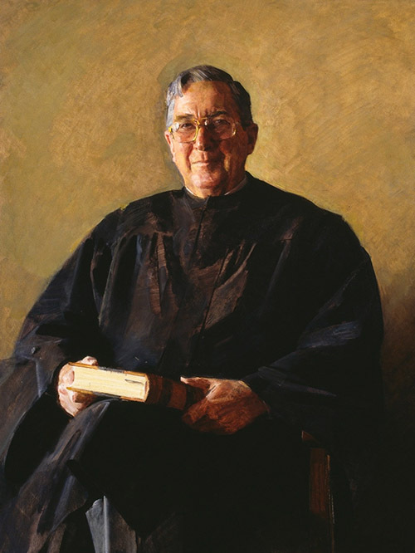
Judicial vs Merits - Attorney-General (NSW) v Quin (1990) 170 CLR
Former magistrate Quin unhappy about losing job in transition to a new system of Local Courts in 1980s.
Quin challenges decision only to let him reapply as part of merits-based selection process.
Policy change was not for the court to question.
Brennan J [18]:
‘[T]he scope of judicial review must be defined not in terms of the protection of individual interests but in
terms of the extent of power and the legality of its exercise. In Australia, the modern development and
expansion of the law of judicial review of administrative action have been achieved by an increasingly
sophisticated exposition of implied limitations on the extent or the exercise of statutory power, but those
limitations are not calculated to secure judicial scrutiny of the merits of a particular case”
Image from case?
Administrative Law –LAW1023

Slide 8

Common Law Judicial Review
Supreme Courts in Australia inherited powers from UK, Including common law judicial review
A system that grew out of prerogative writs and the procedures required by the courts over the years to access them
Driven by remedies referred to as prerogative writs (common law remedies)
  Certiorari – quashing a decision
  Mandamus – mandate the making of a decision
  Prohibition – prevent the making of a wrongful decision
Also equitable remedies derived from private law
  Injunctions
  Declarations
Image from case?
Court of King’s Bench 1460 – Source: Inner Temple Library
Administrative Law –LAW1023

Slide 9
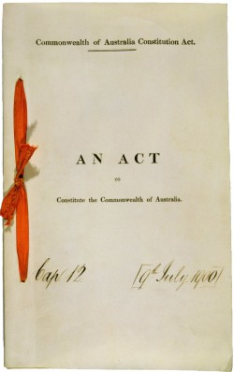
Constitutional judicial review – High Court’s jurisdiction
Chapter III of the Australian Constitution deals with the Judiciary
Section 75 deals with the original (as opposed to appellate) jurisdiction of the High Court
Section 75(v) Australian Constitution sets out the original jurisdiction of the High Court to grant a writ of mandamus, prohibition or an injunction.
  Cf jurisdiction of Supreme Court of Victoria - s 85 of Victorian Constitution (inherent jurisdiction to grant prerogative writs and equitable remedies) see common law judicial review
Separation of powers ?
Administrative Law –LAW1023

Slide 10
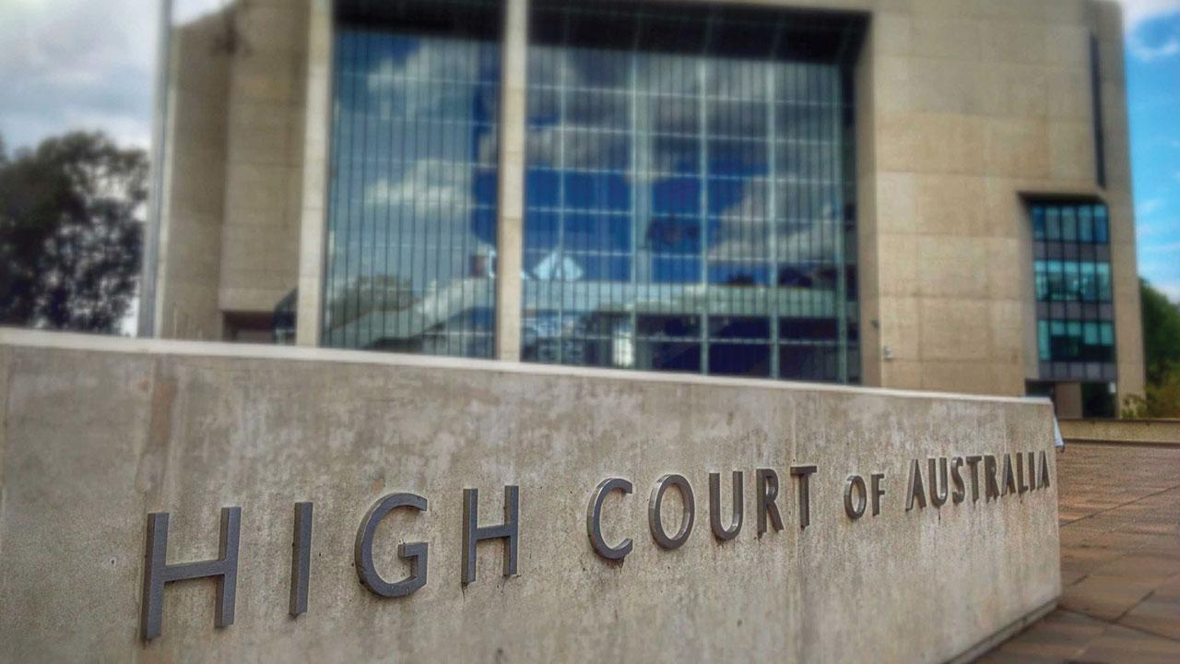
Section 75 – Original jurisdiction of High Court
In all matters:
  (i) arising under any treaty;
  (ii) affecting consuls or other representatives of other countries;
(iii) in which the Commonwealth, or a person suing or being sued on behalf of the Commonwealth, is a party;
(iv) between States, or between residents of different States, or between a State and a resident of another State;
(v) in which a writ of mandamus or prohibition or an injunction is sought against an officer of the Commonwealth;
the High Court shall have original jurisdiction.
Administrative Law –LAW1023

Slide 11
Common law judicial review – High Court Jurisdiction
  S. 32 Judiciary Act 1903 (Cth) gives HC power to grant:
  “The High Court in the exercise of its original jurisdiction in any cause or matter pending before it, whether originated in the High Court or removed into it from another Court, shall have power to grant, and shall grant, either absolutely or on such terms and conditions as are just, all such remedies whatsoever as any of the parties thereto are entitled to in respect of any legal or equitable claim properly brought forward by them respectively in the cause or matter; so that as far as possible all matters in controversy between the parties regarding the cause of action, or arising out of or connected with the cause of action, may be completely and finally determined, and all multiplicity of legal proceedings concerning any of such matters may be avoided.”
  Therefore, Constitution + Judiciary Act give HC power to grant any of the prerogative writs not mentioned in s. 75(v) e.g. certiorari and declaration.
Administrative Law –LAW1023

Slide 12

Judicial review – Federal Court jurisdiction
Section 39B(1) of the Judiciary Act 1903 (Cth) provides
“Subject to subsections (1B), (1C) and (1EA), the original jurisdiction of the Federal Court of
Australia includes jurisdiction with respect to any matter in which a writ of mandamus or
prohibition or an injunction is sought against an officer or officers of the Commonwealth.”
Section 44 (1A) also provides for jurisdiction over matters ‘arising under any laws made by the
Parliament’ and s 44(2A) of the Judiciary Act allows HCA to remit any case it is able to hear to the
Federal Court
Original jurisdiction of these courts is available even when ADJR Act review is unavailable/excluded
Administrative Law –LAW1023

Slide 13

Judicial review – Federal Court jurisdiction
Migration cases have become increasingly higher proportion of Fed Cts’ caseload
Part 8 of the Migration Act (beginning at s 474) is all about judicial review of these cases. Its principal effect is to direct most of them (approx. 90%) to the Federal Circuit and Family Court of Australia (FCFCOA) with appeal to Federal Court.
Review grounds are more restricted than ADJR Act too. One consequence of these restrictions was increasing use of s 75(v) to go straight to HCA
Administrative Law –LAW1023

Slide 14
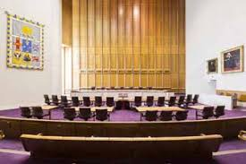
Recap of Judicial Review
Administrative Law –LAW1023

Slide 15
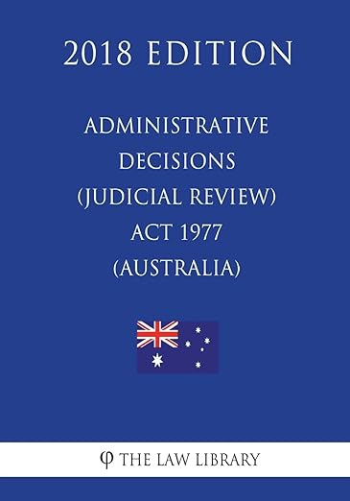
Statutory judicial review – legislation
ADJR Act codifies and simplifies the common law and constitutional review – systems sit in parallel
ADJR Act provides an alternative method of judicial review with following advantages:
  Right to reasons (s 13)
  Less complex procedures (ss 11, 15, 15A)
  More flexible remedies (s 16)
If statutory review not available, may still be able to make original jurisdiction application
Administrative Law –LAW1023

Slide 16
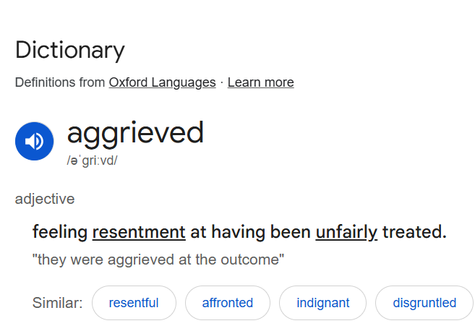
Statutory judicial review – legislation
Section 5 (read in light of definitions in s. 3):
  A person (individual or body corporate)
  aggrieved by
  a decision to which this Act applies
  may apply to Federal Court or the Federal Circuit Court
  order of review
  on any one or more of the following grounds (grounds on next slide)
Administrative Law –LAW1023

Slide 17
ADJR Act – Section 3 - Interpretation
decision to which this Act applies "means a decision of an administrative character made, proposed to be made, or required to be made (whether in the exercise of a discretion or not and whether before or after the commencement of this definition):
(a) under an enactment referred to in paragraph (a), (b), (c), (d) or (e) of the definition of enactment ; or
(b) by a Commonwealth authority or an officer of the Commonwealth under an enactment referred to in paragraph (ca), (cb) or (f) of the definition of enactment ;
other than:
(c) a decision by the Governor - General; or
(d) a decision included in any of the classes of decisions set out in Schedule 1.
Administrative Law –LAW1023

Slide 18

Statutory judicial review – ADJR Act
Section 5(1) – Grounds:
Breach of rules of natural justice
Required procedures not observed
No jurisdiction (jurisdictional error)
Decision not authorised by the enactment
Improper exercise of power (see further s 5(2))
Error of law whether or not on the record
Fraud
No evidence (see further s 5(3))
j) Contrary to law
There is no (i)! This appears to have been a quirk in the drafting process – it wasn’t removed by an amendment – appears it simply never existed.
Administrative Law –LAW1023

Slide 19

Statutory judicial review – ADJR Act
Section 5(2) – Improper exercise of power
Irrelevant consideration(s)
Failure to take into account relevant consideration(s)
Purpose other than statutory one
Bad faith
Exercise of personal discretionary power under direction of another
Failing to take into account merits of particular case
Wednesbury unreasonableness
Uncertain result
j) “Any other exercise of a power in a way that constitutes abuse of the power”
Former Wednesbury Cinema (Source:Wikicommons)
Administrative Law –LAW1023

Slide 20
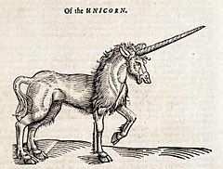
Statutory judicial review – ADJR Act
Section 5(3) – No Evidence
No evidence from which administrator can be reasonably satisfied that ‘particular matter was established’
Decision based on evidence of fact that did not exist
Administrative Law –LAW1023

Slide 21

Statutory judicial review – ADJR Act – Other key provisions
• Section 6 – Applications for review of conduct related to making of decisions
• Section 7 – Applications in respect of failures to make decisions
• Section 10 – Rights conferred by the AD(JR) to be in addition to other rights (eg under common law)
• Section 13 – Reasons for decision may be obtained (within 28 days of request)
• Section 13A – Certain information not required to be disclosed (relating to personal or business affairs of another person)
Source: Creative Commons (Nic Joungson)
Administrative Law –LAW1023

Slide 22
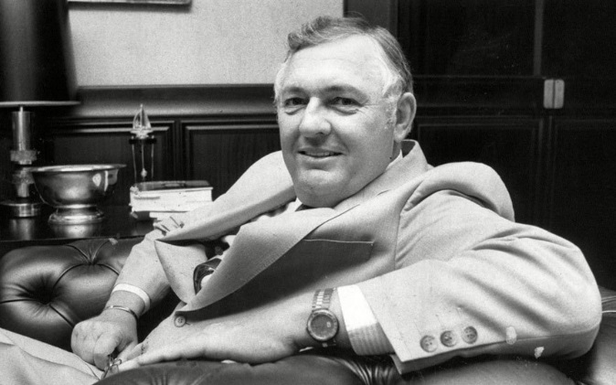

Statutory judicial review – Cth legislation
‘Decision’ (s.3 ) and ‘conduct’ (s. 6)
Australian Broadcasting Tribunal v Bond (1990) 110 CLR 321
Edelsten v Health Insurance Commission (1990) 96 ALR 673
Kelson v Forward (1995) 60 FCR 39
‘Administrative character’ (s. 3)
Federal Airports Corporation v Aerolineas Argentinas (1997) 147 ALR 649
Roche Products Pty Ltd v National Drugs and Poisons Schedule Committee (2007) 163 FCR 451
‘Under an enactment’ (s. 3)
Griffith University v Tang (2005) 221 CLR 99
Alan Bond
Administrative Law –LAW1023
Geoffrey Edelsten

Slide 23
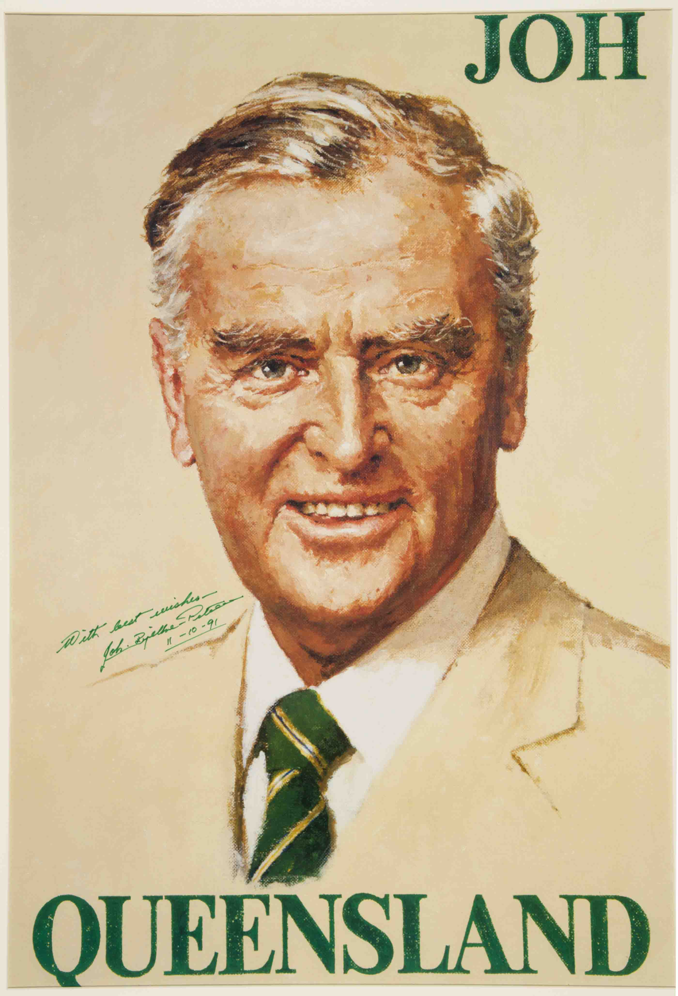
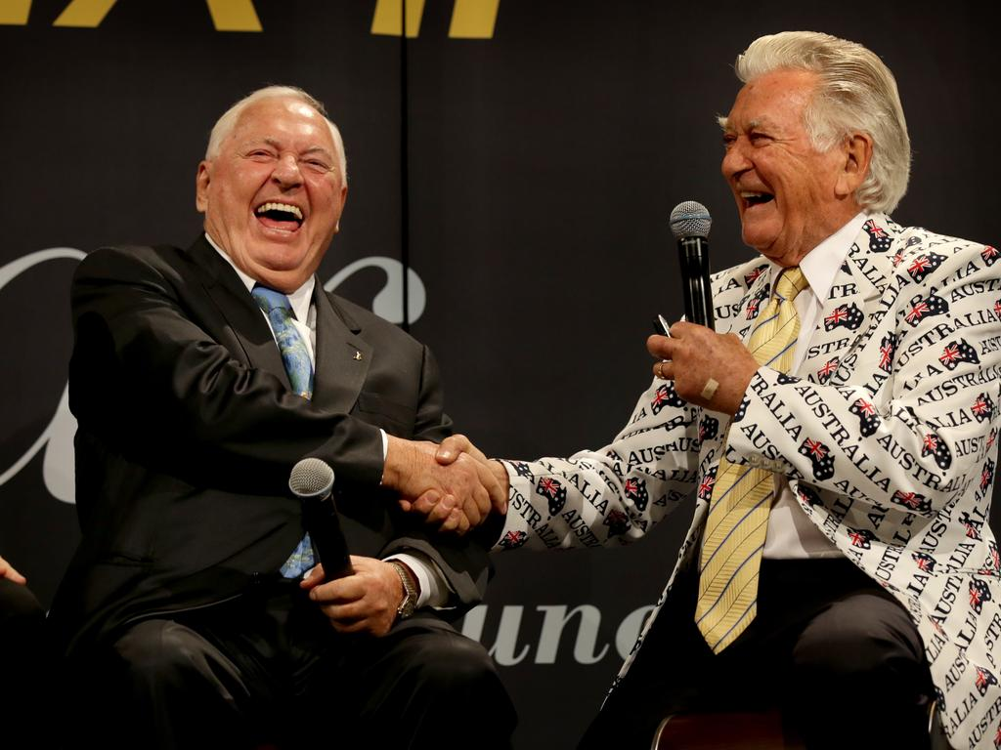
ABT v Bond (1990) 110 CLR 321
Before this case ‘decision’ and conduct were given broad construction, resulting in broad jurisdiction under ADJR Act –Bond investigated by ABT as someone who might not be ‘fit and proper person’ to hold broadcasting licence – had made public statements suggesting bribery and threats
ABT published interim ‘Decision on Facts’ concluding that Bond (and, by extension, his companies who actually held the licences) was not a fit and proper person. No action yet taken eg to cancel or modify licences.
Bond sued ABT under ADJR Act in respect of 11 decisions and 7 instances of conduct
ABT argued that only 1 – the ‘not fit and proper’ finding – met ADJR Act definition
HCA points out that subsections 3(2), 3(3) and 3(5) and indeed s 6 would be unnecessary if Parlament had not meant ‘decision’ to be interpreted relatively narrowly
Concluded that ‘decision’ must be ‘substantive’ and ‘final or operative and determinative’
‘Conduct’ refers to administrative activity preceding a decision that reveals a
flawed administrative process
In this case, findings wrt licencees were ‘decisions’, finding wrt Bond was not,
but NB findings of fact generally not ‘decisions’ – )
Case concerned Bond’s settlement payment to Sir Joh: Campaign Poster: Source: Queensland Museum
Administrative Law –LAW1023

Slide 24

Edelsten v HIC (1990) 96 ALR 673
Edelsten investigated under Health Insurance Commission Act 1973 for claiming excessively under Medicare
Sued Commission after HIC advisers Drs Nearhos and Dash conducted factual investigations and referred the matter to a disciplinary committee respectively
Full Federal Court held that decisions which ‘have real impact upon a person’s rights, privileges or obligations’ should pass Bond test, whereas others will be ‘mere stepping stones which lead ultimately to the making of a decision which does not affect the person’s position’
Administrative Law –LAW1023

Slide 25

Kelson v Forward (1995) 60 FCR 39
Merit Protection and Review Agency (MPRA) had power to inquire into and report to Minister about Commonwealth Government employment issues.
Conducted inquiry into workplace harassment at the War Memorial and reported to Minister
Director of War Memorial sued claiming breaches of natural justice and incorrect test of ‘harassment’
Federal Court held – NB after Bond – that the report was a reviewable ‘decision’ – stood alone as a ‘separate and discrete decision’ and did not ‘fragment’ the admin process; report was had ‘real impact’ on rights and was ‘substantive’ (citing Bond and Edelsten)
Administrative Law –LAW1023

Slide 26
Statutory judicial review – Cth legislation
‘Decision’ (s.3 ) and ‘conduct’ (s. 6)
Australian Broadcasting Tribunal v Bond (1990) 110 CLR 321
Edelsten v Health Insurance Commission (1990) 96 ALR 673
Kelson v Forward (1995) 60 FCR 39
‘Administrative character’ (s. 3)
Federal Airports Corporation v Aerolineas Argentinas (1997) 147 ALR 649
Roche Products Pty Ltd v National Drugs and Poisons Schedule Committee (2007) 163 FCR 451
‘Under an enactment’ (s. 3)
Griffith University v Tang (2005) 221 CLR 99
Alan Bond
Administrative Law –LAW1023
Geoffrey Edelsten

Slide 27

Federal Airports Corporation v Aerolineas Argentinas (1997) 147 ALR 649
Federal Airports Corporation was empowered to impose charges on those using airports
AA challenged a landing fee for large aircraft
Since rule was ‘of general application’ – FAC contended that it was legislative in character rather than administrative
FAC’s hybrid govt/commercial nature was key consideration for Court
Concluded that the determination of a landing fee was part of the ‘execution or administration of the FAC Act’
Administrative Law –LAW1023

Slide 28

Roche Products Pty Ltd v National Drugs and Poisons Schedule Committee (2007) 163 FCR 451
TGA gave National Drugs & Poisons Schedule Committee to determine which substances should be listed on the Poisons Standard – incl. in Appendix H drugs which could be sold over the counter (and advertised for direct sale)
Committee decided to remove weight control drug Orlistat from the relevant Appendix after complaints that it had been promoted on Australian Idol
Fed Court held that the decision of the Committee to amend Appendix H was of a legislative character (ie not reviewable under ADJR Act)
  ‘The distinction is essentially between the creation or formulation of new rules of law having general application and the application of those general rules to particular cases’ (citing Cth v Grunseit (1943) 67 CLR 58)
Listed relevant factors incl. that rule applied to the substance behind Orlistat regardless of mfr; Poisons Standard was part of national legislative scheme; decisions of Committee gazetted and not subject to merits review etc (see further tb [2.4.40C])
Consequence, due to lack of listing on FRLI, was invalidation of Standard! [2.4.41]
Administrative Law –LAW1023

Slide 29
Statutory judicial review – Cth legislation
‘Decision’ (s.3 ) and ‘conduct’ (s. 6)
Australian Broadcasting Tribunal v Bond (1990) 110 CLR 321
Edelsten v Health Insurance Commission (1990) 96 ALR 673
Kelson v Forward (1995) 60 FCR 39
‘Administrative character’ (s. 3)
Federal Airports Corporation v Aerolineas Argentinas (1997) 147 ALR 649
Roche Products Pty Ltd v National Drugs and Poisons Schedule Committee (2007) 163 FCR 451
‘Under an enactment’ (s. 3)
Griffith University v Tang (2005) 221 CLR 99
Alan Bond
Administrative Law –LAW1023
Geoffrey Edelsten

Slide 30

Griffith University v Tang (2005) 221 CLR 99
S 3 def. of ‘enactment’ = Commonwealth Act and any instrument made under such an Act
How broad is ‘instrument’ though?
Ms Tang, postgrad student, challenges decision made by Uni committee that she had engaged in academic misconduct (falsified data for PhD) and ending her candidature
HCA held that the decision to terminate her candidature was not made under the Griffith University Act 1998 or university statutes; rather under a policy on misconduct
Test adopted by HCA is that a decision will only be ‘made under an enactment’ for ADJR purposes if it ‘derive[d] from the enactment the capacity to affect legal rights and obligations’ or ‘took its legal force or effect from statute’
NB power to make the decision can be implied by the enactment; need not be express
Court noted that relationship between Tang and the university was ‘voluntary’ and involved no contractual relationship – decision made eg to fire an academic would be different.
Administrative Law –LAW1023

Slide 31

Statutory judicial review – Vic legislation
Administrative Law Act 1978 (Vic) is similar to ADJR Act, with major difference being that it does not specify grounds on which the review may be granted
Doesn’t independently specify the types of relief which may be granted either
S. 3 – Any person affected by a decision of a tribunal may make application (hereinafter called an application for review) to the Supreme Court for an order calling on the tribunal or the members thereof (hereinafter called an order for review) and also any party interested in maintaining the decision to show cause why the same should not be reviewed.
Court determines the remedy to be applied
Administrative Law –LAW1023

Slide 32
Summary
Judicial review of decisions – legality only
Justiciability in an important concept
Next we turn to questions of jurisdiction and jurisdictional error
Administrative Law –LAW1023

Slide 33

Recap
Recap of Statutory
Judicial Review
Administrative Law –LAW1023

Slide 34
Justiciability
What is it?
When does it apply?
What is the effect?
What is the current state of the case law?
Administrative Law –LAW1023

Slide 35
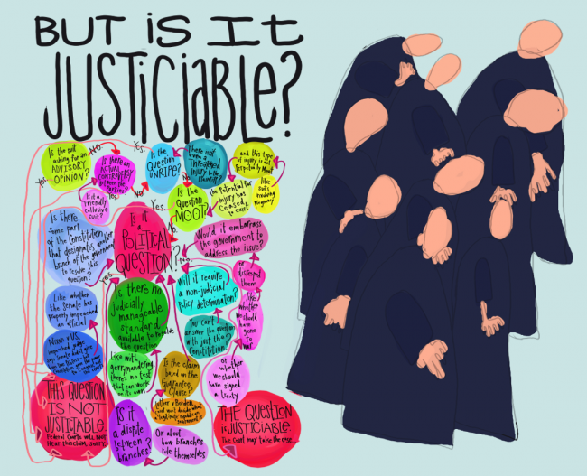
Justiciability
Ask: 1. Can the court resolve the conflict?
2. Should the conflict be resolved by the
court?
When: 1. What is the status of the decision maker?
2. What is the source of the power exercised?
3. What is the nature of the power?
4. What is involved in the exercise of that power?
Administrative Law –LAW1023

Slide 36
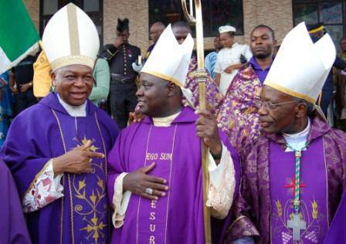
Justiciability
Is it appropriate for the courts to review any government decision?
Under s 75, the High Court (& by extension other Ch III courts) can only resolve ‘matters’ – what does this mean? See eg Re McBain; Ex Parte Catholic Bishops’ Conference (2002) 209 CLR 372 ‘justiciable controversy between the parties’ – also related to standing (Topic 6)
Typical exclusions:
Exercise of prerogative power; made by cabinet; close relationship with national security; made in the conduct of international relations and ‘operational’ decisions
These exclusions are not blanket ones though – see following cases:
Hicks v Ruddock (2007) 156 FCR 574
Re: McBain; Ex-parte Australian Catholic Bishops Conference (2002) 209 CLR 372
Minister for Arts, Heritage and Environment v Peko-Wallsend (1987) 15 FCR 27
Administrative Law –LAW1023

Slide 37



Hicks v Ruddock (2007) 156 FCR 574
David Hicks was an Australian citizen by birth who travelled overseas to assist, in some capacity, with groups associated with the Taliban, sometime around 1999.
In about 2001, he was picked up in Afghanistan by the US and eventually transported to Guantanamo Bay. He was held there, without charge, for 5 years. This attracted a lot of criticism for the alleged grave breaches of human rights.
His legal counsel in Australia filed a writ of habeas corpus in an attempt to get Mr Hicks some access to justice.
The Australian Government applied to have his claim struck out, stating – amongst other arguments – that it was non-justiciable.
Tamberlin J held that there was at least some prospect that the case would succeed and struck out Ruddock’s application.
The significance of this decision is that the non-justiciability may be narrower than previously thought, and that some matters concerning foreign affairs and foreign governments may be justiciable after all.
Administrative Law –LAW1023

Slide 38

Re: McBain; Ex-parte Australian Catholic Bishops Conference (2002) 209 CLR 372
s8 Infertility Treatment Act 1995 (Vic) restricted in vitro treatment to women who were married or with a de facto partner. Dr Bain bought an action under s109 of the Constitution claiming that the law was inconsistent with the Sex Discrimination Act 1984 (Cth).
Australian Catholic Bishops Conference and Australian Episcopal Conference of the Roman Catholic Church joined the proceedings as amicus curiae, then appealed to the High Court under s76 of the Constitution.
The majority followed In re Judiciary and Navigation Act (1921) 29 CLR 257 – in order for the High Court to consider s76, there needed be some “immediate right, duty or liability” to be determined by the Court.
Administrative Law –LAW1023

Slide 39

Minister for Arts, Heritage and Environment v Peko-Wallsend (1987) 15 FCR 274
The Peko-Wallsend Case arose when the applicants sought to challenge a Federal cabinet decision to nominate Stage 2 of the Kakadu National Park for World Heritage listing. The nomination was submitted to the World Heritage Committee in accordance with Article 11 of the World Heritage Convention. By this Article States parties undertake to submit suitable properties to the World Heritage Committee for consideration for inclusion on the World Heritage List.
Peko, who owned 1% of total area, were concerned that their rights would be extinguished.
All the appeal judges (Beaumont, Sheppard, Wilcox JJ) found that the decision to nominate was made under the prerogative and that such decisions may, in some circumstances, be open to judicial review, but not in this case.
Administrative Law –LAW1023

Slide 40
Recap - Justicability
Administrative Law –LAW1023

Slide 41
Jurisdictional Error
In this topic, we will consider:
Jurisdictional Error
Jurisdictional vs non-jurisdictional errors of law
JE and the ADJR Act
Historical origins of the concept
The modern notion of JE in UK vs Australia
Errors of law on the face of the record
Administrative Law –LAW1023

Slide 42
Grounds and Classifications of Error
We have studied the preliminary issues of jurisdiction as well as the core of the course which are the grounds for review (under the ADJR Act and Common Law)
We now need to identify:
  The courts’ ability to review certain grounds (‘question of law’)
  The kind of error that has occurred (whether jurisdictional or not)
  The legal consequences of an error
JE is “conclusory” its like metadata ‘tag’ put on certain grounds
Administrative Law –LAW1023

Slide 43
ADJR Act and JE – An Awkward Relationship
ADJR Act section 5(1)(c):
‘…that the person who purported to make the decision did not have jurisdiction to make the decision’.
Overlaps significantly with other grounds (such as those relating to fact-finding errors)
Was more popular from 1994-2001, when the Migration Act excluded many other grounds of ADJR review via privative clauses
This is not a relevant question if you have established another ground under the ADJR Act. You can go directly to remedies under s 16.
Administrative Law –LAW1023

Slide 44

Why do we need to know whether an error is jurisdictional?
JE is relevant to common law review (in the State Supreme Courts), review under s 39B of the Judiciary Act (FCA) and s 75(v) of the Constitution (HCA)
Remedies: certain remedies are only available in such common law proceedings, namely: prohibition, mandamus (though NB they are also available where an error of law appears ‘on the face of the record’) –Certiorari also available for JE.
Consequences: Certain consequences flow from an error being ‘jurisdictional’
Constitutional significance: HCA has said that the minimum of its constitutionally entrenched jurisdiction over administrative action is to review for jurisdictional error. The same is true for State Supreme Courts.
Administrative Law –LAW1023

Slide 45

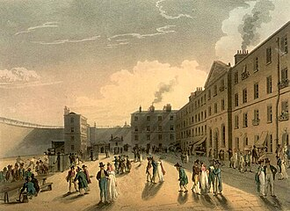
Historical Origins
Prohibition and Certiorari developed to remedy errors made by inferior courts. These are bodies which are expert in interpreting the law. So superior courts would only review their errors if they were particularly serious or obvious.
Drew the line between errors that took court outside jurisdiction entirely (JE) vs those within legal authority – eg misapplying rules within jurisdiction (non-JE).
JE means decision is invalid/void ab initio
King’s Bench Prison by Pugin
Administrative Law –LAW1023

Slide 46

Historical Origins
Prohibition could be used to prevent a decision-maker from exercising power that they do not have (making a JE).
Certiorari could be used to quash a decision affected by JE, or an error of law on the face of the record.
Mandamus always applied to admin decsion makers, not courts. However, jurisprudence on mandamus borrowed concept of JE from prohibition. Mandamus requires a duty to be ‘unperformed.’ A duty which has in fact been performed may remain unperformed in law if it is attended by JE.
The idea of a JE is a carry-over from the
historical development of the remedies.
Administrative Law –LAW1023

Slide 47

What WAS a Jurisdictional Error?
Historically very narrow (most errors within jurisdiction)
Generally understood as an error that meant that a decision-maker had no authority to enter into the discretionary decision-making process in the first place, as opposed to errors in the exercise of that power. i.e. commencement theory/preliminary or collateral errors.
Eg the Police Disciplinary Board is empowered to ‘dismiss Police Officers for misconduct’. The term ‘Police Officers’ is defined in the legislation as officers who have successfully completed their probationary period. If the Board purports to dismiss an officer during their probationary period, then they will have acted outside their jurisdiction in the traditional, narrow sense.
Note overlap with idea of jurisdictional facts
Administrative Law –LAW1023

Slide 48
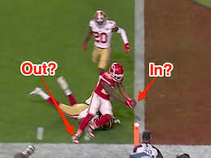
Jurisdictional Error in the UK
The commencement approach was highly malleable, and difficult to apply in real life (we’ve seen this already with jurisdictional facts in the Malaysia Declaration Case).
Anisminic Ltd v Foreign Compensation Commission [1969] 2 AC 147
The House of Lords criticised the JE/non-JE distinction. Lord Reid stated that a decision-maker can step outside of the lawful boundaries of their authority even when they have legitimately commenced an inquiry. i.e If a tribunal decides based on an irrelevant factor, they have acted outside their legal authority just as much as if they are mistaken as to a jurisdictional fact.
In subsequent cases the UK has abolished the idea of JE altogether.
Administrative Law –LAW1023

Slide 49
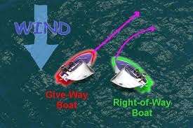
Modern Notion of Jurisdictional Error in Australia
Meanwhile in Australia, the HCA has held that the Constitution requires the distinction to be maintained.
Re Refugee Tribunal; Ex parte Aala (2000) 204 CLR 82:
S 75(v) entrenches remedies (prohibition, mandamus and injunction) which, at the time of Federation, could only apply to JE. Core of what s 75(v) protects is review for JE.
Therefore it took a different tack from UK courts.
Administrative Law –LAW1023

Slide 50

Craig v SA (1995) 184 CLR 163
Background: District Court judge stayed proceedings in larceny case (Craig charged with stealing cars) on ground that C should have had legal representation (following Dietrich v R (1992) 177 CLR 292).
No appeal available re such a decision. Prosecution sought judicial review in SCSA. SCSA issued certiorari (quashed decision).
Craig appealed to HCA (ie HCA exercising s 73 appellate jurisdiction – determining availability of remedies under common law rather than s 75)
HCA Judgment
Certiorari only available under common law for:
  Jurisdictional errors; or
  Errors of law on the face of the record.
What is a JE? Obvious eg is civil court deciding a criminal matter.
Should we follow abolition of JE/non-JE distinction in Anisminic?
Australia is in a different constitutional position to UK. JE required for constitutional reasons.
Administrative Law –LAW1023

Slide 51
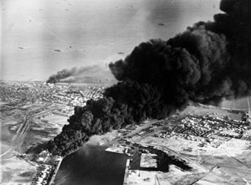
Craig v SA (1995) 184 CLR 163
When will a tribunal (or other executive decision maker) make a JE?
"... there are many cases where, although the tribunal had jurisdiction to enter on the inquiry, it has done or failed to do something in the course of the inquiry which is of such a nature that its decision is a nullity. It may have given its decision in bad faith. It may have made a decision which it had no power to make. It may have failed in the course of the inquiry to comply with the requirements of natural justice. It may in perfect good faith have misconstrued the provisions giving it power to act so that it failed to deal with the question remitted to it and decided some question which was not remitted to it. It may have refused to take into account something which it was required to take into account. Or it may have based its decision on some matter which, under the provisions setting it up, it had no right to take into account. I do not intend this list to be exhaustive. But if it decides a question remitted to it for decision without committing any of these errors it is as much entitled to decide that question wrongly as it is to decide it rightly” (citing Anisminic, per Lord Reid).
Anisimic concerned eligibility for compensation from nationalization of British assets in Egypt after the Suez Crisis
Administrative Law –LAW1023

Slide 52

Craig v SA (1995) 184 CLR 163
Essentially HoL in Anisminic pointed out that, if you can vitiate/quash/overturn a decision based on a ground of review, you might as well call that ground a jurisdictional error.
HCA admitted that errors made by a d-m in eg misconstruing a statute on which its jurisdiction is based (and therefore misconceiving its proper function) may be hard to distinguish from errors made in the course of exercising jurisdiction (see pp 177-178 of Craig).
Nevertheless, SoP in Constitution requires we keep the distinction, esp. for admin d-ms and tribunals (though not for courts, which have the authority to determine the extent of their own jurisdiction within limits)
Administrative Law –LAW1023

Slide 53

Kirk v Industrial Court (NSW) (2010) 239 CLR 531
Facts
Kirk owned farm in NSW
Mr Palmer worked on farm; sadly killed using ATV to deliver
steel to back paddock (rolled down steep hill)
Kirk convicted of offences under Occupational Health and Safety Act 1983 (NSW) in Industrial Court of NSW
Industrial Relations Act 1996 (NSW) provided that decisions could be appealed to Full Bench of Industrial Court, but were otherwise ‘final and [could not] be appealed against, reviewed, quashed or called into question by any court or tribunal.’
Kirk argued JE or error of law on face of record in NSW Court of Appeal; was denied.
Administrative Law –LAW1023

Slide 54
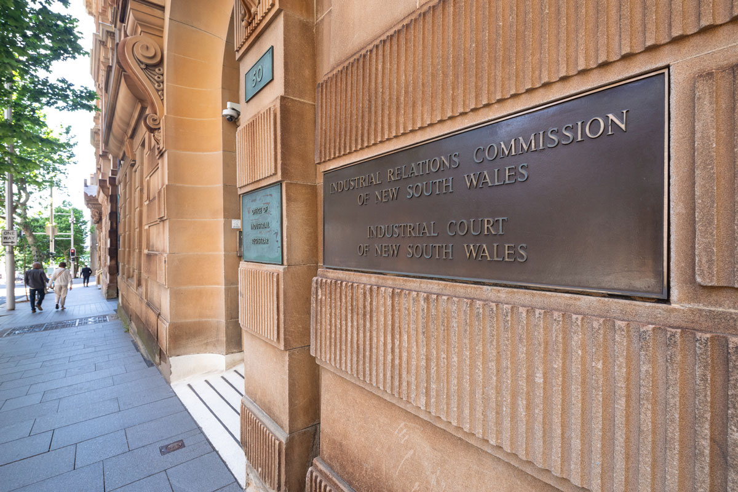
Kirk v Industrial Court (NSW) (2010) 239 CLR 531
HCA Judgment
Appeal to HCA allowed (privative clauses cannot oust State Supreme Courts’ ability to rule on JE any more than they can HCA’s jurisdiction under s 75(v)).
Industrial Court had misconstrued OH&S Act provisions re orders it had made. Also made mistakes in allowing certain evidence to be called. Not JEs under traditional commencement theory (rather errors in course of exercising jurisdiction).
HCA held the errors did amount to JE.
The distinction between tribunals and courts drawn in Craig (ie cts can determine own jurisdiction; tribunals cannot) is based on an assumption that it is possible to distinguish between inferior courts and tribunals.
HCA said it is not at the State level – no strict SoP (at p 573).
‘Decision’ of IR Court was thus in fact no decision at all.
Administrative Law –LAW1023

Slide 55

What are the boundaries?
Kirk - “It is neither necessary, nor possible, to attempt to mark the metes and bounds of jurisdictional error.”
Nevertheless, we have Professor Mark Aronson’s list:
A mistaken assertion or denial of the very existence of jurisdiction.
A misapprehension or disregard of the nature or limits of the decision-maker's functions or powers.
Acting wholly or partly outside the general area of the decision-maker's jurisdiction, by entertaining issues or making the types of decisions or orders which are forbidden under any circumstances. An example would be a civil court trying a criminal charge.
Mistakes as to the existence of a jurisdictional fact or other requirement when the relevant Act treats that fact or requirement as something which must exist objectively as a condition precedent to the validity of the challenged decision.
Disregarding relevant considerations or paying regard to irrelevant considerations, if the proper construction of the relevant Act is that such errors should result in invalidity.
Some, but not all, errors of law. In particular, if the decision-maker is an inferior court or other legally qualified adjudicative body, the error is likely to be jurisdictional only if it amounts to a misconception of the nature of the function being performed or of the body's powers.
Acting in bad faith.
Breaching the hearing or bias rules of natural justice.
Administrative Law –LAW1023

Slide 56
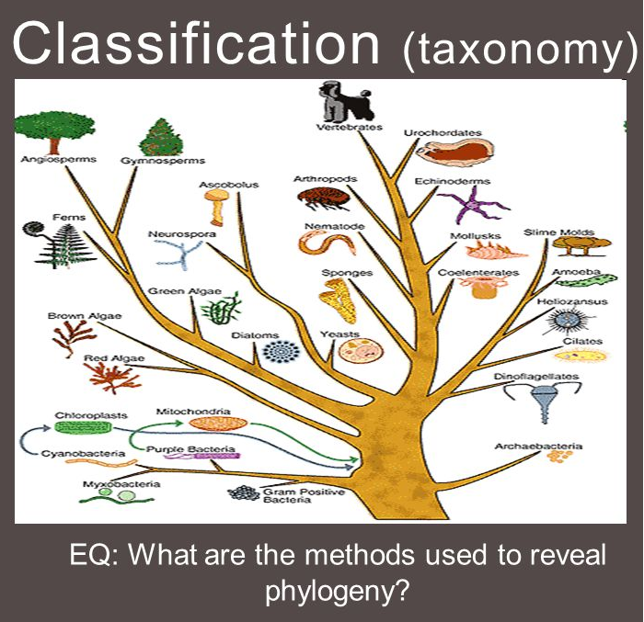
Kirk v Industrial Court (NSW) (2010) 239 CLR 531
‘There is no rigid taxonomy’
Question depends on the nature of the limits of a body’s functions or powers. This required construction of the statute, with following in mind:
  Has the body properly construed, and stayed within, the powers granted by the empowering legislation?
  Did the body have power to do what it has purported to do?
  Is Parliament taken to have intended to have authorised the action?
Administrative Law –LAW1023

Slide 57
Kirk v Industrial Court (NSW) (2010) 239 CLR 531
So What is a Jurisdictional Error?
“There is a jurisdictional error if the decision maker makes a decision outside the limits of the functions and powers conferred on him or her, or does something which he or she lacks power to do. By contrast, incorrectly deciding something which the decision maker is authorised to decide is an error within jurisdiction (this is sometimes described as authority to go wrong, that is, to decide matters within jurisdiction incorrectly). The former kind of error concerns departures from limits upon the exercise of power. The latter does not.” (Quoting Aala, at 571 [66])
“Such an error of law is jurisdictional error which will invalidate any order or decision of the tribunal which reflects it.” (Quoting Craig, at 572 [67])
Ie: JE = an error which leads to invalidity (based on Parliament’s intention as expressed in the relevant legislation).
Administrative Law –LAW1023

Slide 58


How does a court determine whether Parliament intended an error to invalidate a decision?
The return of Project Blue Sky!
Is there anything express in the statute? e.g a clause which provides that failure to comply with a procedural requirement does not lead to invalidity?
Eg Income Tax Assessment Act 1936 (Cth), s 175 (considered in Commissioner of Taxation v Futuris (2008) 237 CLR 146)
“The validity of any assessment shall not be affected by reason that any of the provisions of this Act have not been complied with.”
Ie Parliament can expressly prescribe the intended effect of an error. No invalidity = non JE.
Administrative Law –LAW1023

Slide 59
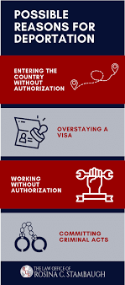
How does a court determine whether Parliament intended an error to invalidate a decision?
What can we glean from examining the empowering provision in its statutory context?
Are there other provisions in the Act which state/imply that breach doesn’t lead to invalidity? Eg are there other provisions of the Act which assume compliance?
How easy is it for the decision-maker to comply (recall in Project Blue Sky the requirement to have regard to international treaties in general was not ‘rule-like’, and would have been difficult to follow in practice).
See also Re Minister for Immigration and Multicultural Affairs; Ex parte Palme (2003) 216 CLR 212.
Reasons generally generated after decision made. Therefore not intended to affect authority to make.
NB there was also a ‘no invalidity’ clause.
Administrative Law –LAW1023

Slide 60
How does a court determine whether Parliament intended an error to invalidate a decision?
What about the broader purposes of the Act, and the context in which it operates?
Eg what are the broader consequences of invalidity?
Recall in Project Blue Sky, if breach were to invalidate, the result would be uncertainty for the industry, and it would be impossible to make standards.
See also Bare v IBAC [2015] VSCA 197:
Concerned breach of s 38 of Victorian Charter by a public authority (Vic Police).
If breach of Charter by public authority results in invalidity, other provisions of the Charter may be constitutionally invalid according to Kirk principles (also, Charter rights not ‘rule-like’ according to some Justices – see Momcilovic v R [2011] HCA 34).
Administrative Law –LAW1023

Slide 61
Summary
Judicial review of decisions – legality only
Note three types of judicial review common law, constitutional and statutory and the requirements of each
Consider the effect of justiciability
And the impact of jurisdictional error
Administrative Law –LAW1023

Slide 62
—
Questions?
Email
richard.taylor2@rmit.edu.au

